Slide 1
Analysis and Recommendations
Office of Graduate Admissions, Worcester Polytechnic Institute
Team 4: Ajuzieogu Nnenna Jennifer, Brian McKay, and Kushal Shah

Slide 2

Office of Graduate Admissions
The analysis focuses on the Office of graduate admissions.
The goal of this project is to analyze the departments existing information systems, processes, networks, and data stores.
Point of Contact: Senior Assistant Director, Paige Dunn.

Slide 3
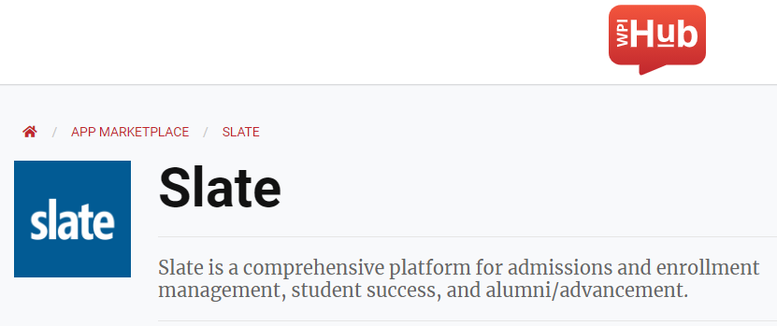
Operations Overview
Use of Slate as their constituent relationship management (CRM) platform.
Primary application/operating system used by all staff daily.
Stores sensitive student PII such as application data, addresses, financial information, SSN’s, etc.
Use of Acxiom as their primary data management platform (DMP).
Loader for application data between Slate and BannerWeb (soon to be WorkDay).
Used to upload transcripts and other sensitive documents.

Slide 4
Information Security Management Analysis

Slide 5
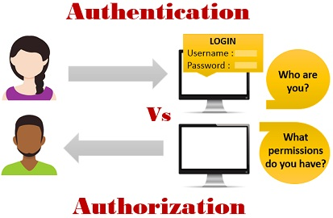
Identification & Authentication
Identification is simply who a user is. It is a naming system that employees must use to gain access into Slate. Authentication establishes the claim of an identity as being true.
Vulnerabilities
The lack of password rules for Slate
Indefinite login time within Slate
Recommendation
Implementing a password policy to all WPI user accounts
Slate should have a limited login time and “remember me” features.

Slide 6
Authorization & Access Control
Authorization controls the degree of access and the capacity to change, alter, or spread sensitive data. Access control is a security measure used to minimize authorized access to the physical and logical systems.
Vulnerabilities
The lack of a contingency plan within department in case of a cyberattack
Recommendation
Creating a contingency plan that is precise and straight-forward.

Slide 7
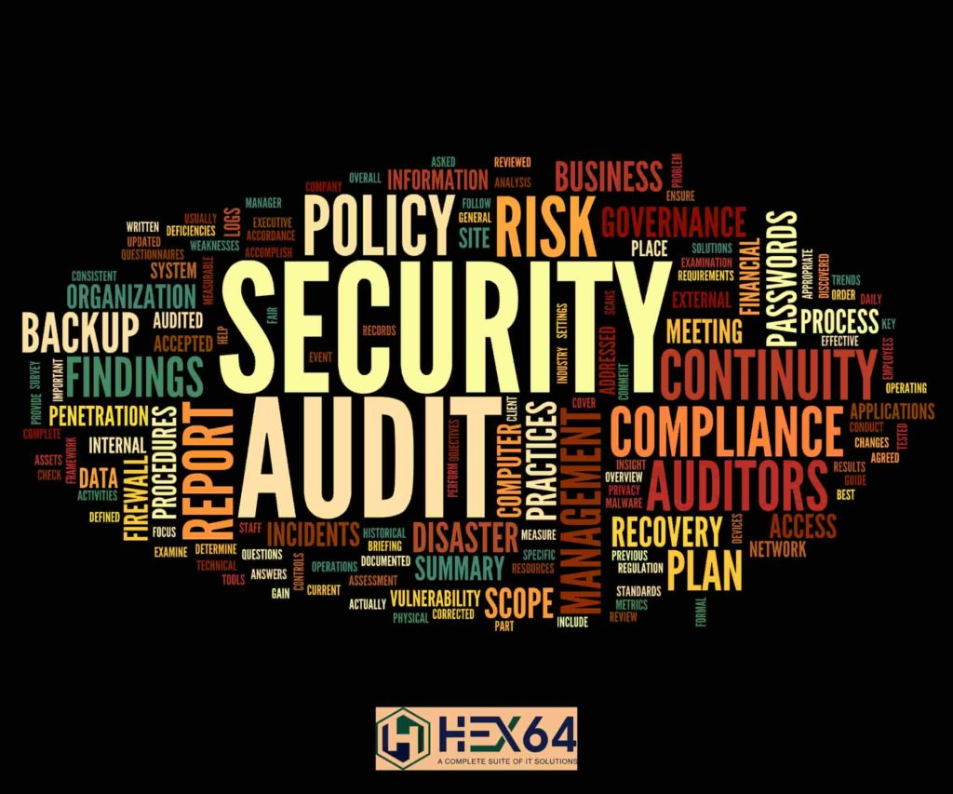
Accountability & Auditing
Accountability enables the tracing of activities within our system/environment back to their source. Auditing tests and assess the organization’s overall security posture.
Vulnerabilities
The lack of an auditing plan within the department
Recommendation
A detailed audit plan that provides specific guideline to be followed when conducting an audit

Slide 8
Cryptography
Ensures confidentiality and integrity of data.
Slate uses industry-recognized security safeguards.
Transmission of this data is protected using Secure Socket Layer (SSL) protocol encryption.
Acxiom’s data centers and operations are System and Organization Controls (SOC2) certified.
VPN connection is used which utilizes encryption using IPSec.
Recommendations:
Regularly monitor the cryptographic algorithms and processes that are implemented within these applications.
Actively apply security updates to ensure compliance of cryptographic algorithms.

Slide 9
Operations Security
Operations security is often referred to as OPSEC. It not only means putting countermeasures in place, but it also specifies an understanding and identifying what data we need to protect.
Vulnerabilities
Clickjacking, not using HTTP Strict-Transport-Security (HSTS) or Content Security Policy (CSP) headers, Rate limiting,Velocity throttling and other DDoS based issues.
Recommendations
Using a CSP to whitelist domains that can embed the page.
HSTS and CSP to be used to ensure Secure sites only
Reducing the time between password attempts or captcha to prevent brute forcing and Resource management allocation for preventing DDoS attacks.

Slide 10
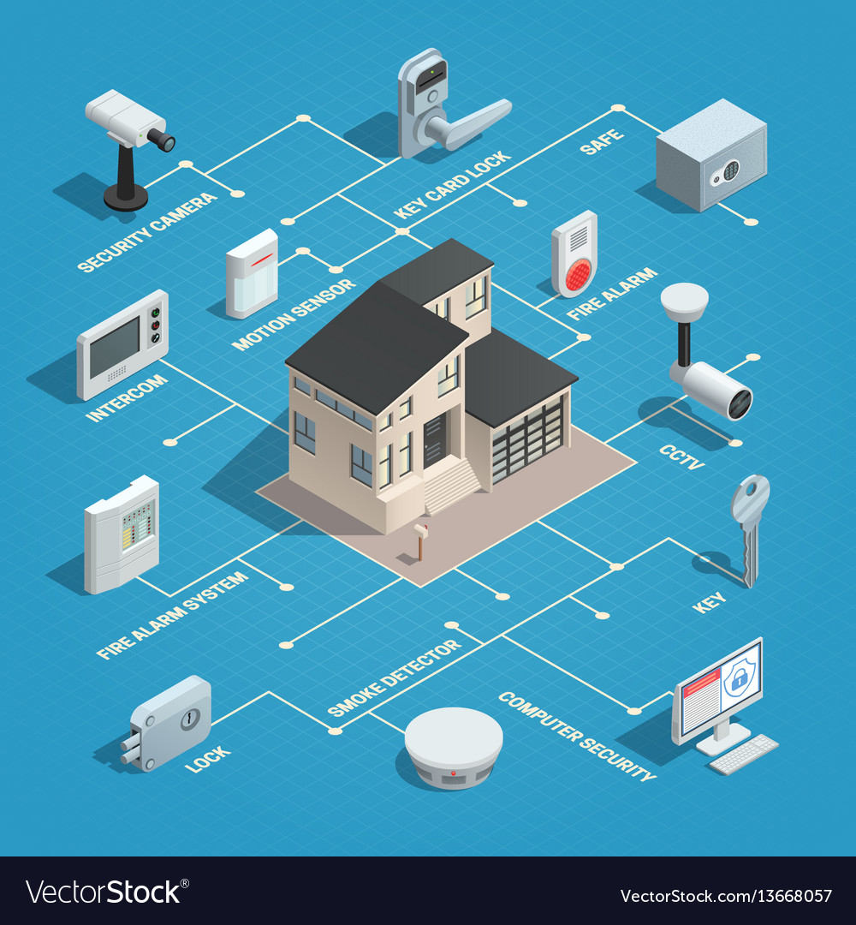
Physical Security
Protection of people, data, and equipment.
Vulnerabilities:
Challenges from remote-work; protection of each employee in their home.
Residual PII data within Slate is not monitored or deleted.
Non-enforced policies or administrative controls on college-owned devices.
Recommendations:
Remote-work security policies
Remote administrative controls limiting VPN connectivity and running background security processes.
Yearly audits of residual data in Slate

Slide 11
Network Security
The Office of Graduate Admissions utilizes a VPN connection for remote-work.
Vulnerabilities
The VPN could avoid the risks of the network intrusion, but not issues like outdated software, unlicensed products, or trojan horses. It means that even if one system is compromised, it allows the hackers to gain access to the whole VPN network by piggybacking on that one system
Recommendation
Ensure policies like Domain-based Message Authentication, Reporting, and Conformance (DMARC) are in place before employees open their emails and the licenses are regularly updated.

Slide 12
Operating Systems and Application Security
Operating systems are one of the largest areas to find vulnerabilities. We can add tools and systems to protect the operating systems as, without securing them, we do not have a foothold in security systems. Several software issues can compromise application security. WPI makes use of the application and OS of Slate to have a relatively secure base.
Vulnerabilities
Slate states that personal Information once de-identified is not subject to Slate’s privacy policy and may treat it as non-Personal Information. Student data is also never cleared.
Recommendation
Making sure the student data is cleared after a certain number of years and updating the software and keeping licenses updated as well.

Slide 13
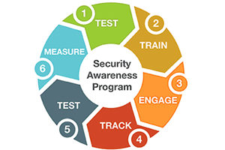
Security Awareness Program
Social engineering and phishing campaigns are active threats.
Vulnerabilities:
No comprehensive security awareness program.
Recommendations:
Staff receive yearly education training and awareness.
Form of modules and quizzed at the end of each module.
Receive a certificate after all modules are complete.

Slide 14
Conclusions
Vulnerabilities analysed demand a stronger information security plan.
Defense in depth will ensure stronger security
Implement the given recommendations!
Our recommendations will ensure confidentiality, integrity, and availability of all information system resources.

Slide 15
References
Images
https://www.imarslan.com/authentication-different-techniques
https://www.hex64.net/information-security-audit-services-benefits-business-process/
https://www.globallearningsystems.com/culture-of-learning-security-awareness-program/
https://www.vectorstock.com/royalty-free-vector/physical-security-isometric-flowchart-vector-13668057

